Slide 1
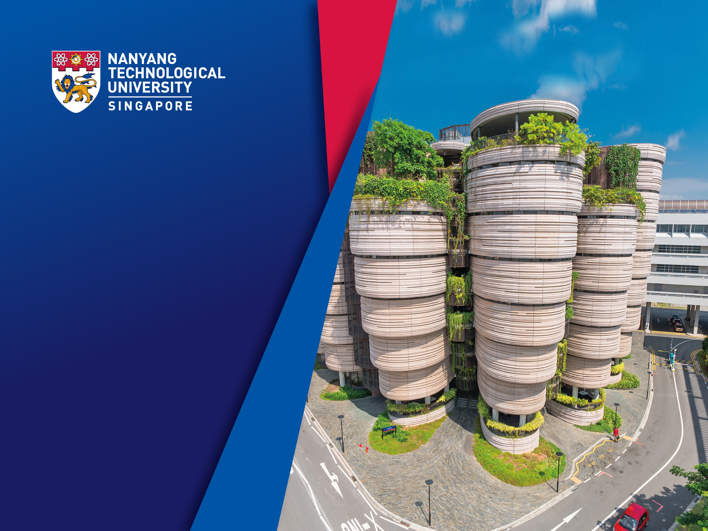
AI
Teoh Teik Toe
ITOM/NBS
ttteoh@ntu.edu.sg
97905202

Slide 2
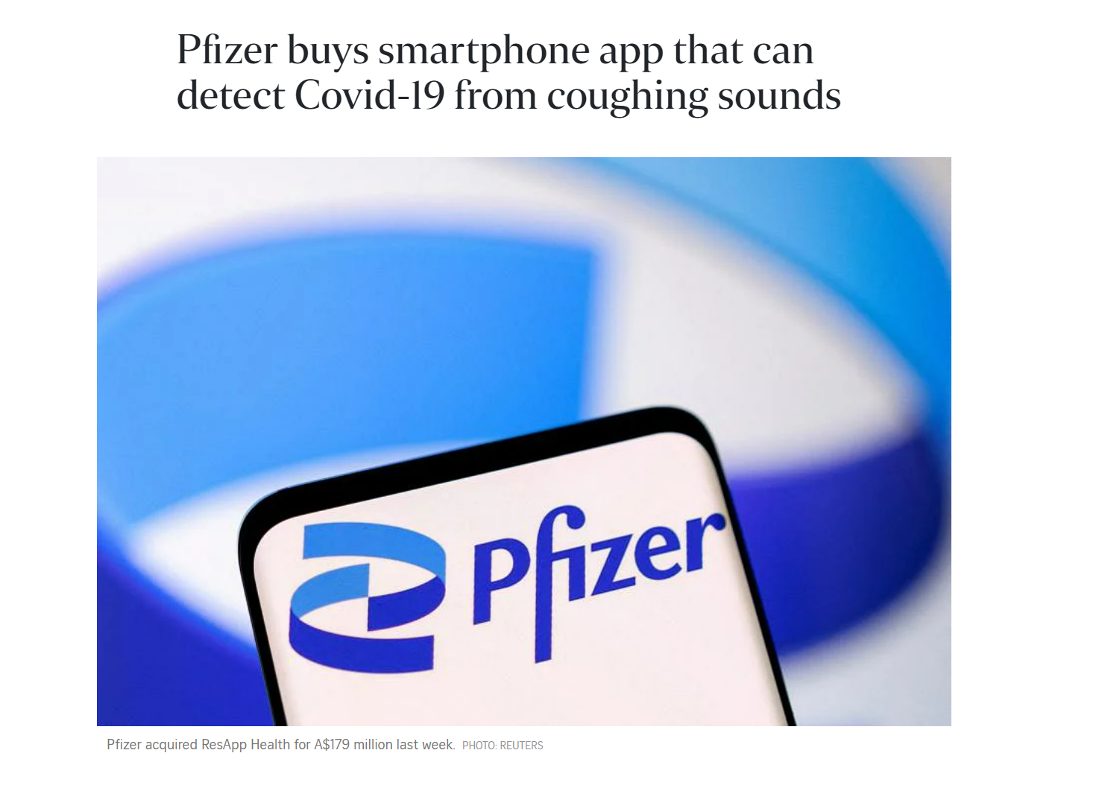
https://www.straitstimes.com/asia/australianz/pfizer-buys-smartphone-app-that-can-detect-covid-19-from-coughing-sounds

Slide 3
Agenda
Intro to AI
AI Models
https://tssglobalsingapore-my.sharepoint.com/:f:/g/personal/teohteiktoe_tssglobalsingapore_onmicrosoft_com/EuIUbA0qyvFOugKwzm5IKesB_qwPBHox0n9mnlGqaRZ_xg?e=TSJM80

Slide 4
AI
AI
Supervised
Unsupervised
Generative
Reinforcement Learning

Slide 5
AI course Embedding (Structured the unstructured) Reinforcement Learning, GAN not covered
AI/ML
Structured CSV (regression, tree, neural)
Continuous Y (Regressor)
Categorical Y(Classifier)
Unstructured (Text, Image)
Text (Embedding TFIDF)
Image (Embedding CNN Resnet)
Supervised
(Classifier) Confusion Matrix, ROC, Precision Recall, Accuracy
Unsupervised (Clustering)
- RMSE, MSE, MAE
Supervised (Classifier)
Unsupervised(Clustering)
Supervised (Classifier)
Unsupervised (Clustering)
Reinforcement Learning
Generative

Slide 6
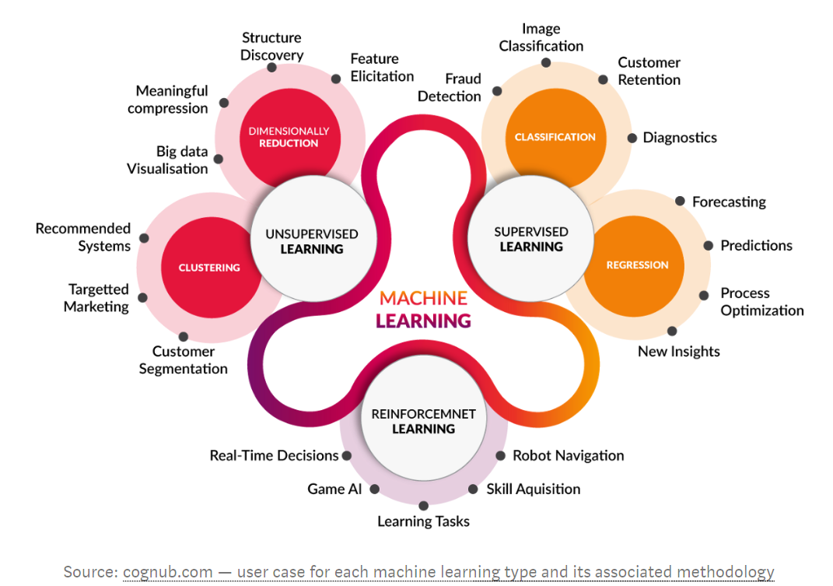
Machine Learning types

Slide 7
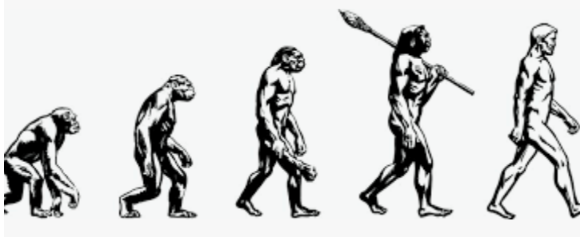
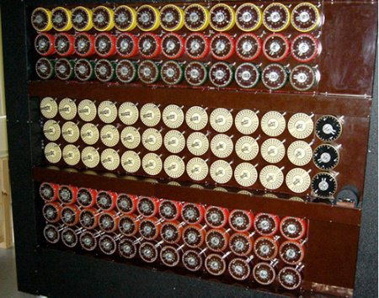
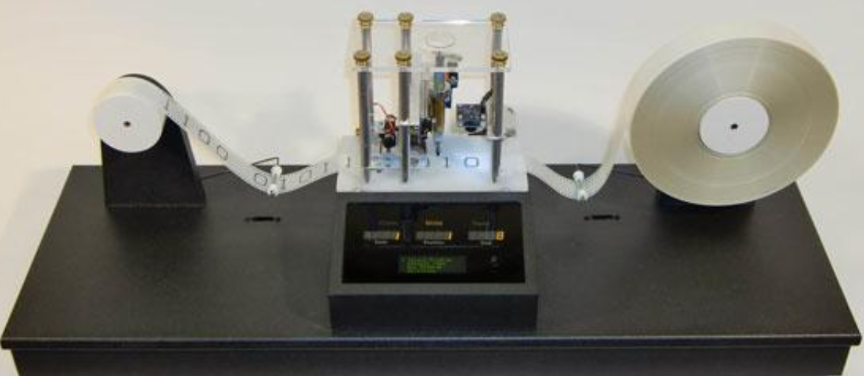
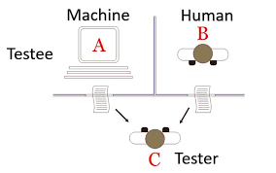
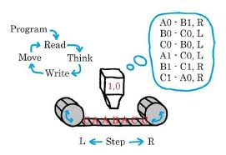
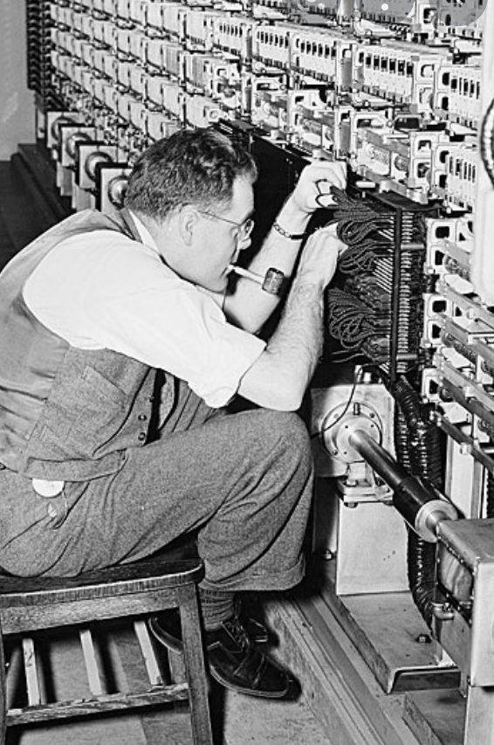

The beginning - Can machines think? 1936 Alan Turing – Turing Machine 1950 Turing Test
Turing test, in which a computer tries to fool the system into thinking that it is a human

Slide 8
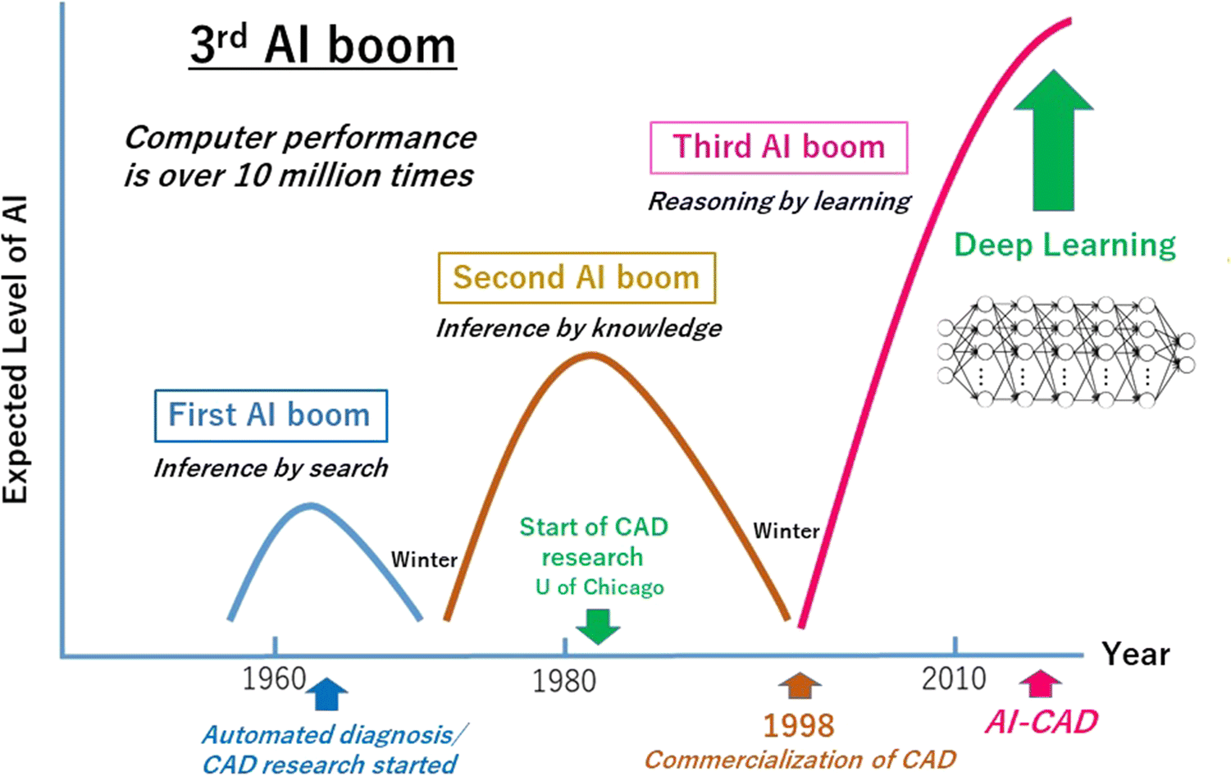
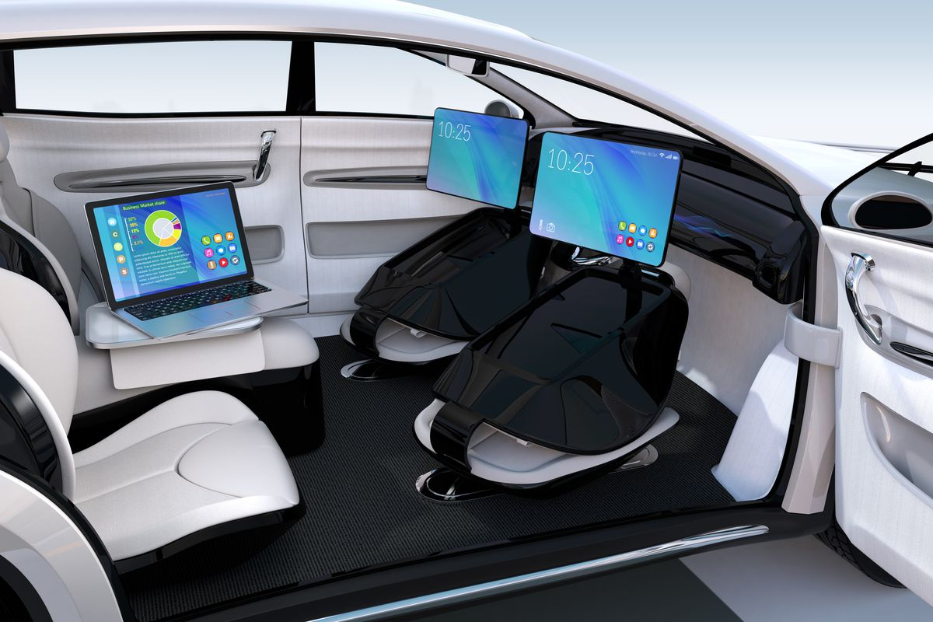
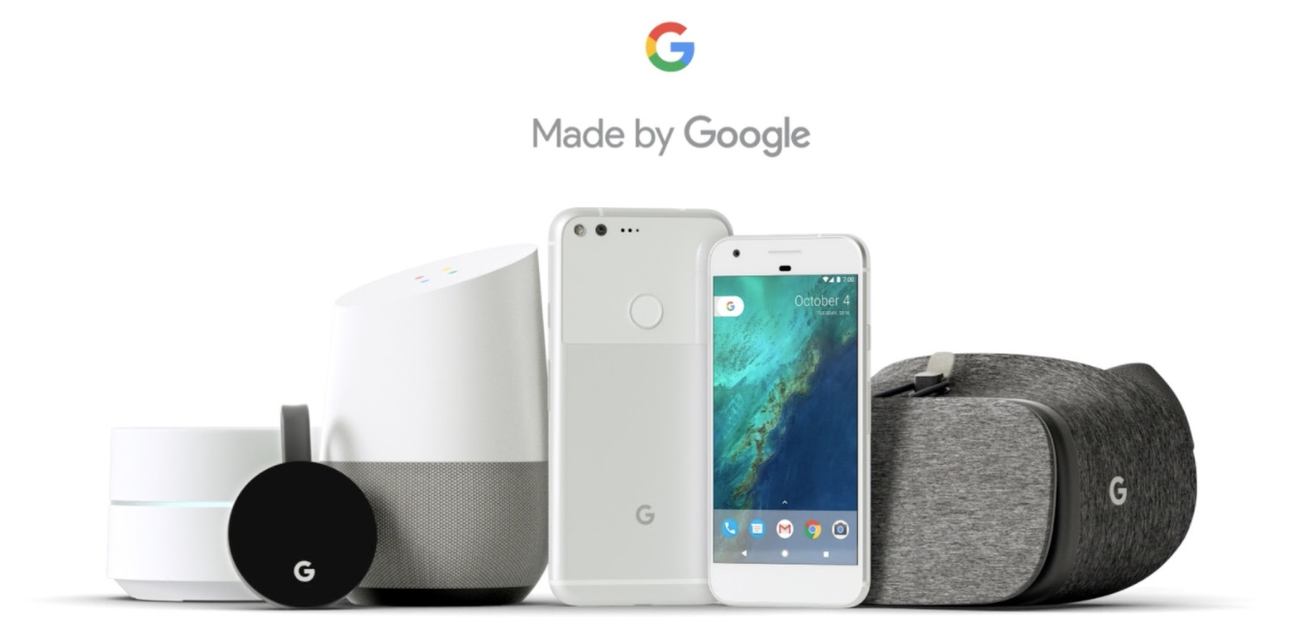
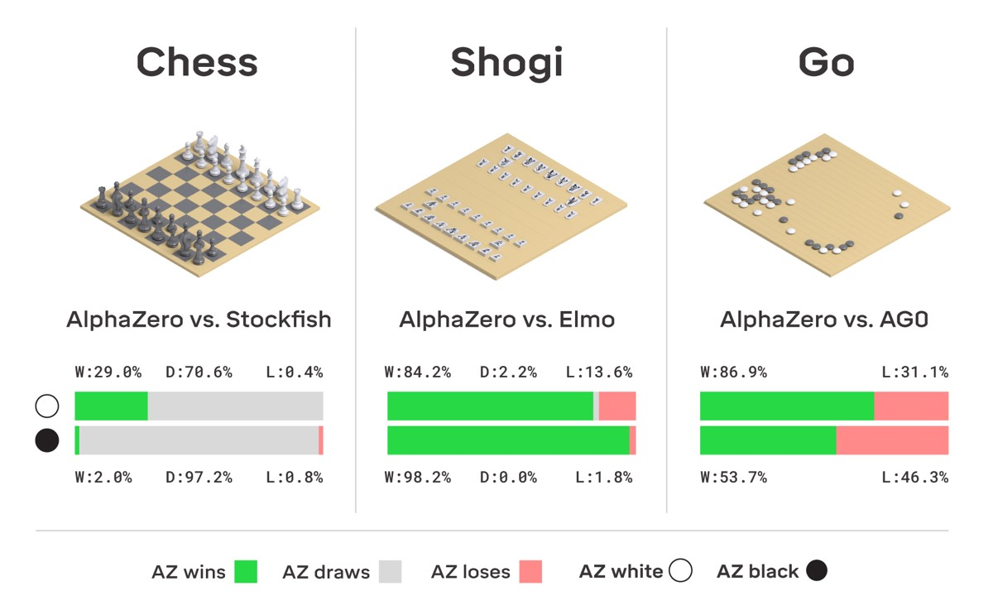
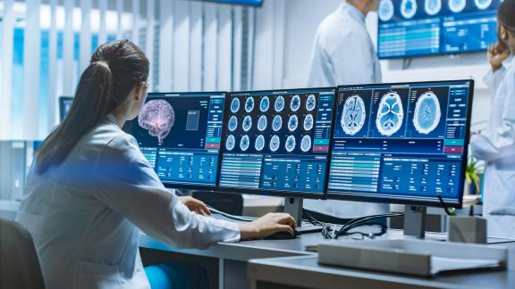
Now

Slide 9
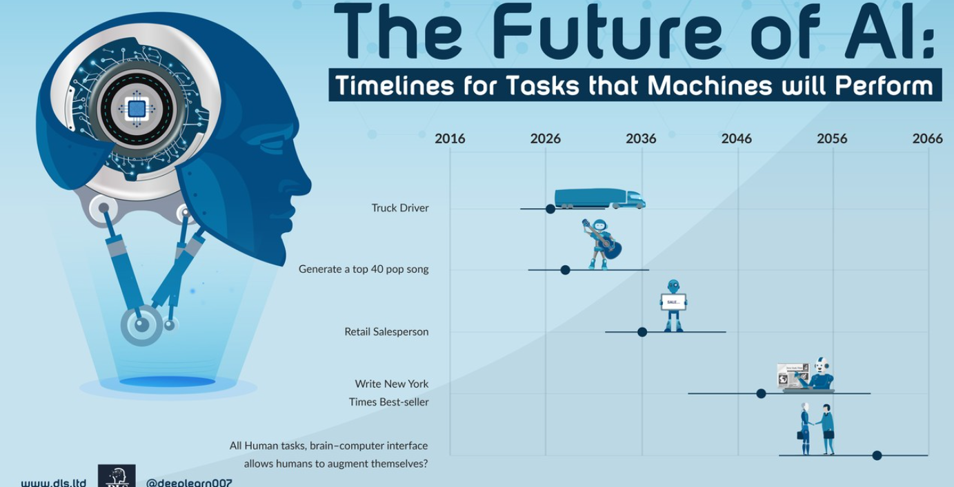
The Future

Slide 10
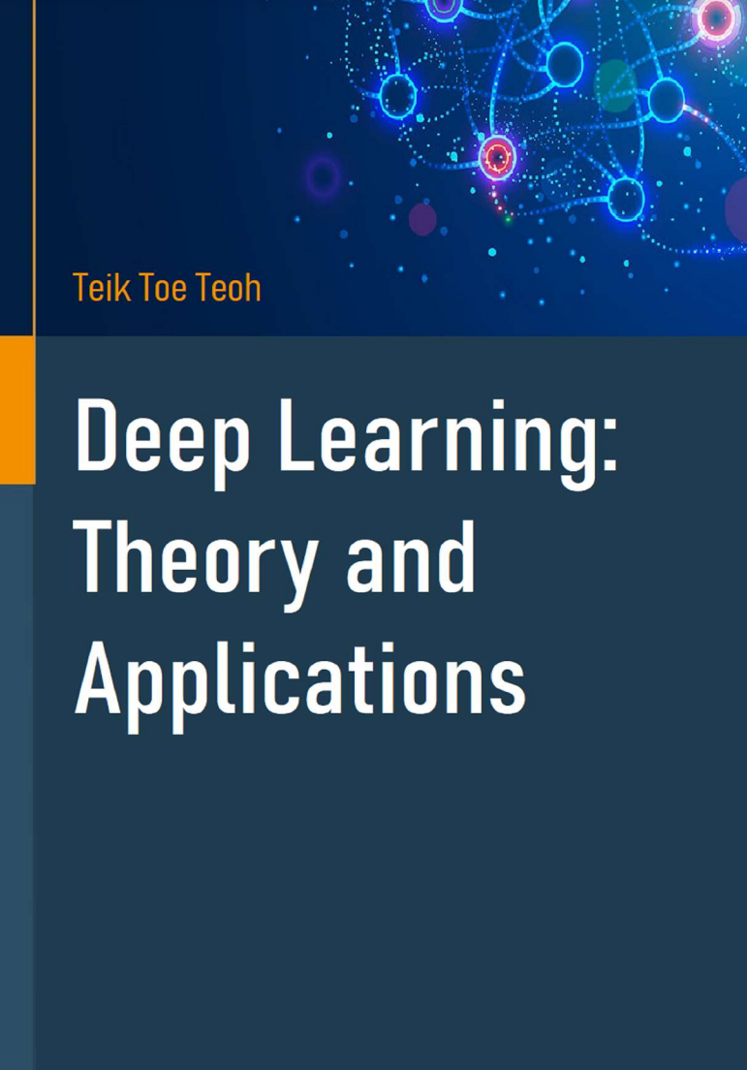
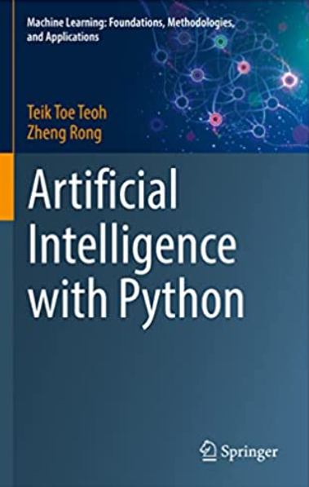

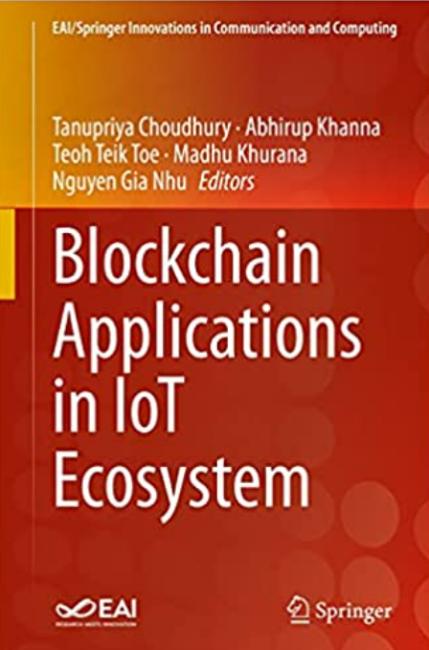
Book – All in Amazon and by Springer
https://tssglobalsingapore-my.sharepoint.com/:f:/g/personal/teohteiktoe_tssglobalsingapore_onmicrosoft_com/EuIUbA0qyvFOugKwzm5IKesB_qwPBHox0n9mnlGqaRZ_xg?e=R70M28

Slide 11
Reading : Textbook
Main
TT Teoh AI in Business & Finance Springer 2021
Artificial Intelligence in Finance. HilPisch. O’Reilly. 2019.
Python for Data Analysis, 2e: Data Wrangling with Pandas, Numpy, and Ipython. Wes Mckinney. O’Reilly. 3 November 2017
Secondary
Artificial Intelligence in Finance: A Python-Based Guide (1st Edition). Yves Hilpisch. O’Really. 2020.
Mathematics for Machine Learning. Marc Peter Deisenroth. Publisher : Cambridge University Press. 2020.
Machine Learning in Finance: From Theory to Practice by Dixon, Matthew F
PattePattern Classification, 2nd Edition Richard O. Duda, Peter E. Hart, David G. Stork. Publication : Wiley.
Hands-on Machine Learning with Scikit-Learn, Keras, and TensorFlow: Concepts, Tools, and Techniques to Build Intelligent Systems, 15 October 2019 by Aurelien Geron (Author)

Slide 12
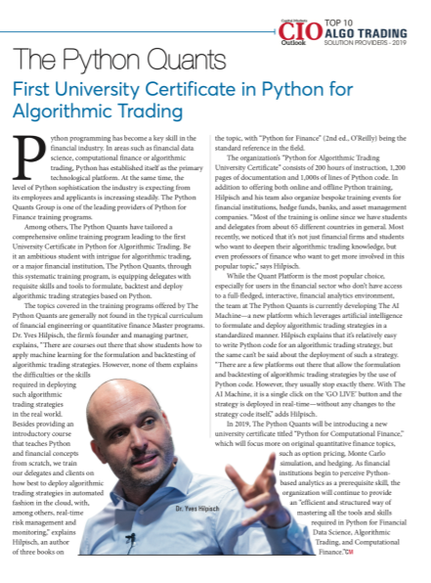
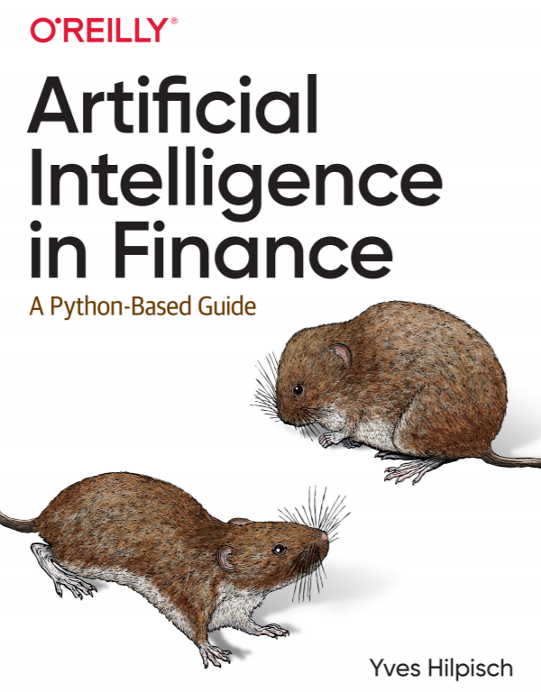
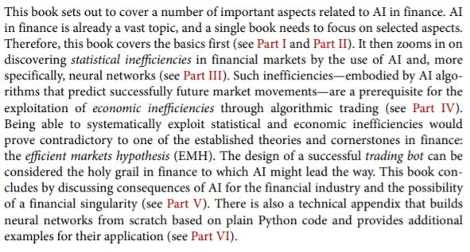

Hilpisch, 2019

Slide 13
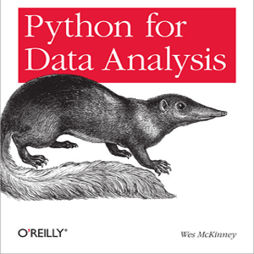

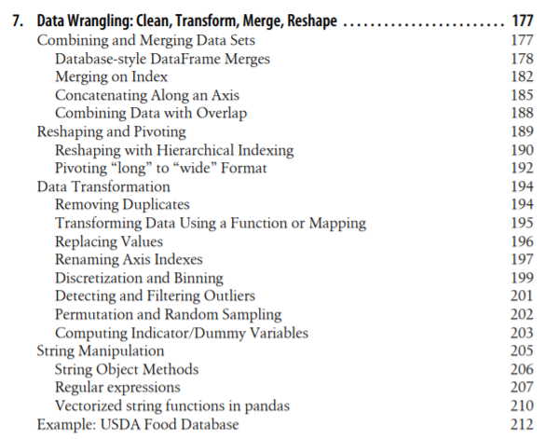
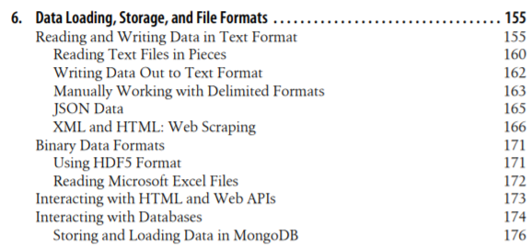
Mckinney, 2017

Slide 14
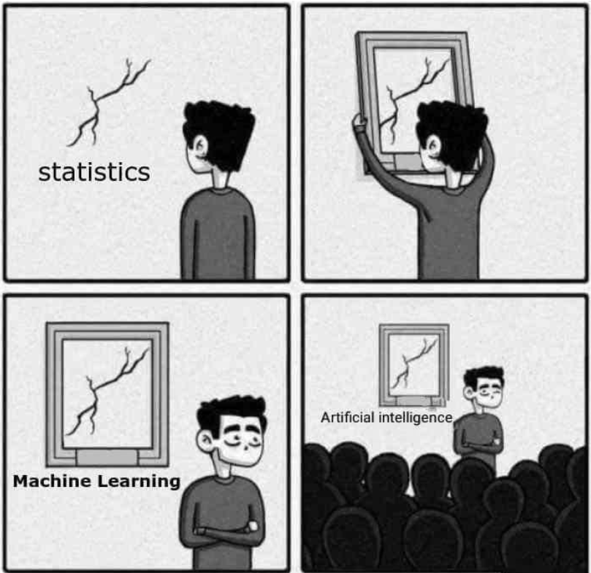
https://images.app.goo.gl/n6DPX9sR1Ue2n8CaA

Slide 15
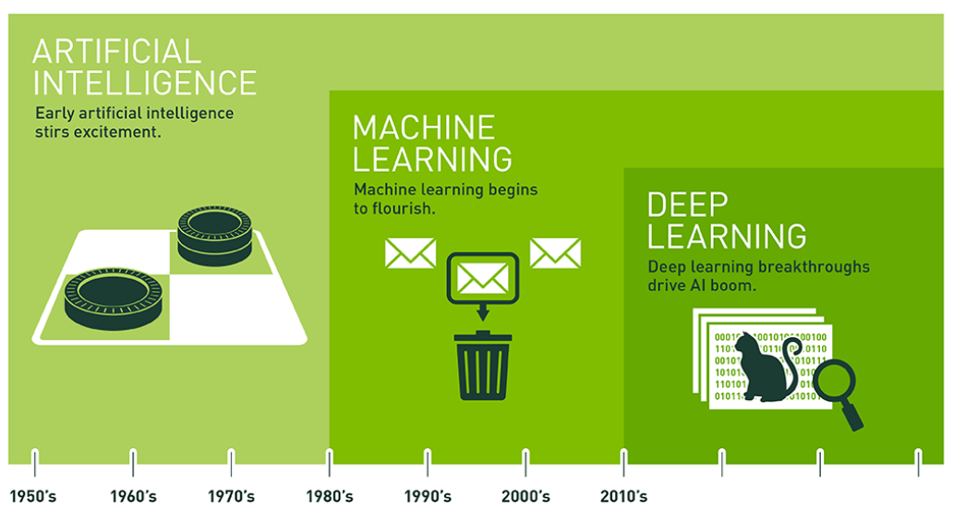
AI terminology
https://blogs.nvidia.com/blog/2016/07/29/whats-difference-artificial-intelligence-machine-learning-deep-learning-ai/

Slide 16
Components of AI
Analytics
Prediction
Automation

Slide 17
AI and other technology
AI and Big Data
Internet of Thing
Robotic Process Engineering
Block Chain
AI & Big Data
Cloud
Natural Language Processing

Slide 18
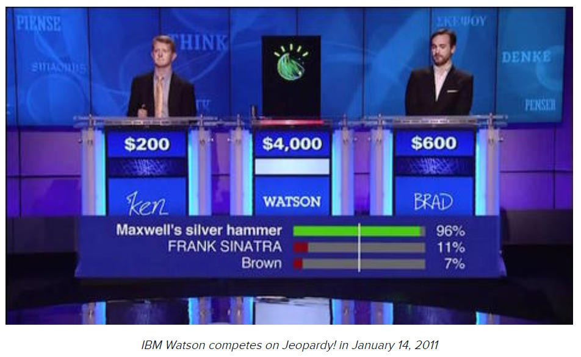
What is AI
Back in the 1950s, the fathers of the field, Minsky and McCarthy, described artificial intelligence as any task performed by a machine that would have previously been considered to require human intelligence.
https://www.zdnet.com/article/what-is-ai-everything-you-need-to-know-about-artificial-intelligence/

Slide 19
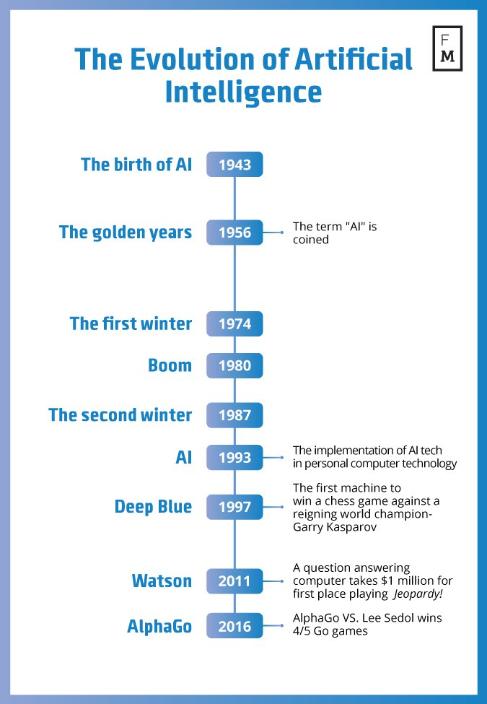
Evolution in AI
Source: https://davidlecea.wordpress.com/2016/11/10/robots-on-the-rise-how-ai-can-change-the-financial-world/

Slide 20

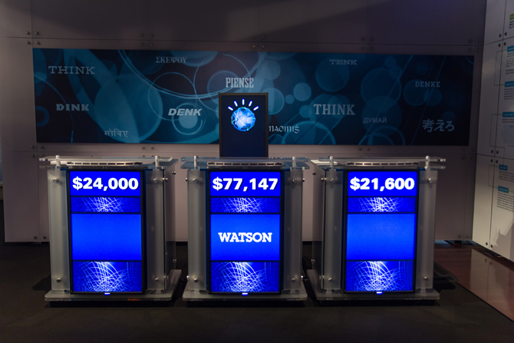
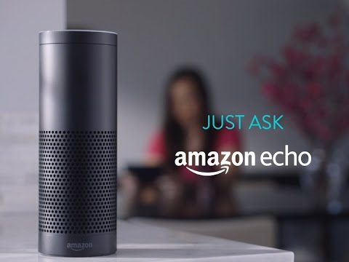
AI
AI : Machine to imitate intelligent human behavior
Popular AI Machine : IBM Watson, Apple Siri, Amazon Echo, Alpha Zero, Xiao Du
Source: https://sanvada.com/2018/01/27/ibm-believes-artificial-intelligence-will-change-world/
Source: https://tecake.in/amazon-echo-will-now-read-twitter-trends-alexa-assistant-updated

Slide 21
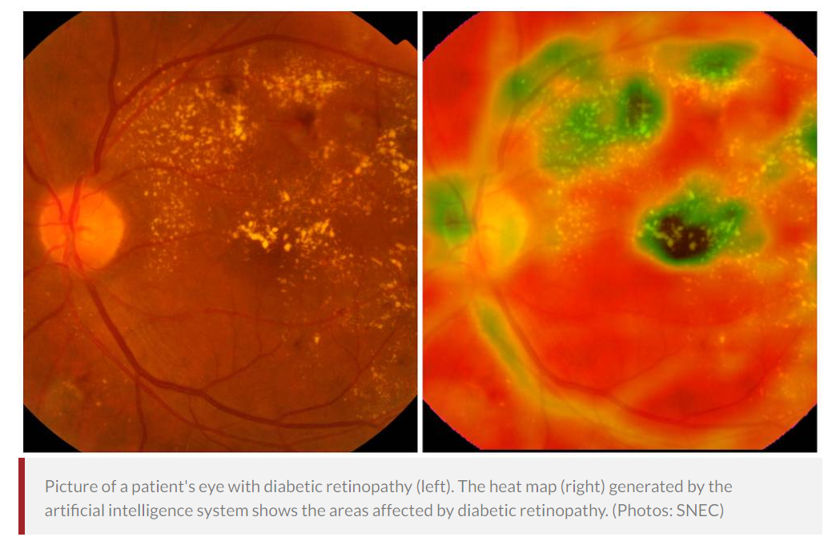
Singapore AI: Detect Eye Conditions
In a world first, Singapore-developed artificial intelligence system detects 3 major eye conditions
Singapore National Eye Centre (SNEC), Singapore Eye Research Institute (SERI) and National University of Singapore (NUS) School of Computing.
Deep Learning System (DLS)
5 million images next 5 years
30 co-investigators
500,000 retinal images
180,000 out of 600,000 Singaporeans with diabetes have diabetic retinopathy – lead to blindness.
https://www.channelnewsasia.com/news/singapore/in-a-world-first-singapore-developed-artificial-intelligence-9498742

Slide 22
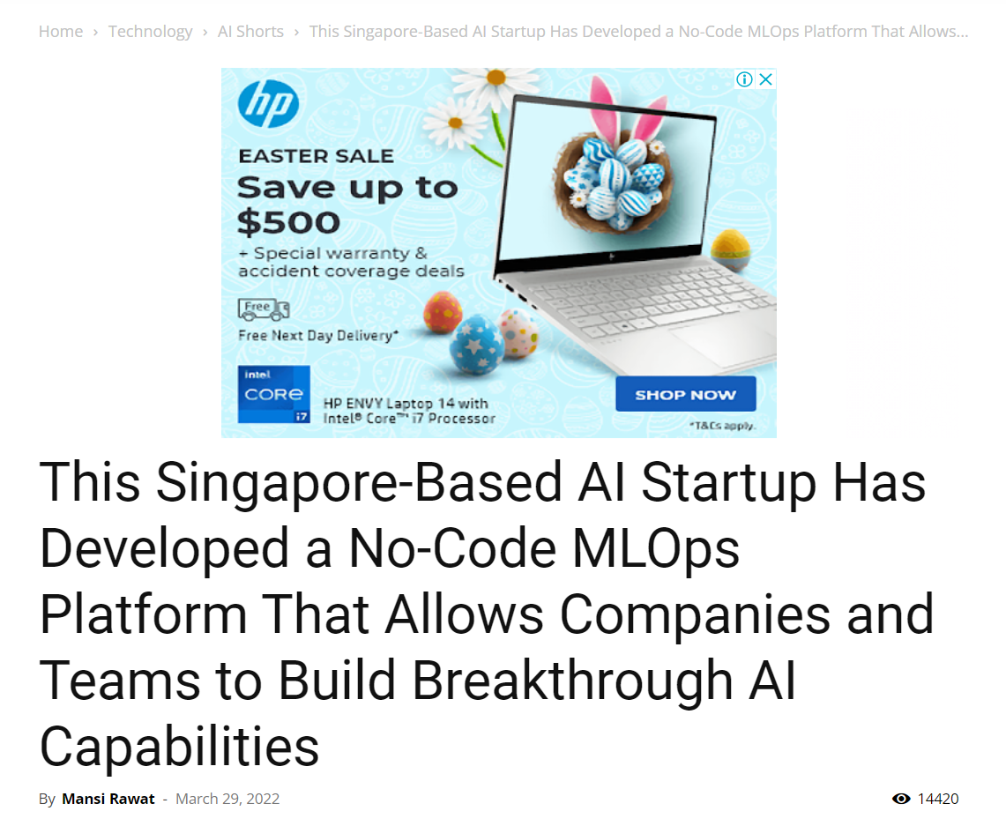
March 2022 No-Code AI made in Singapore

Slide 23
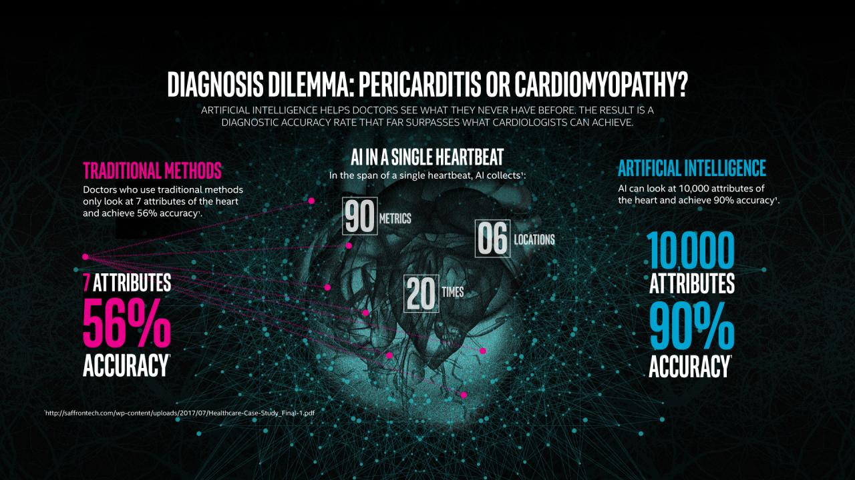
Cardiologist vs AI
Source: https://www.intel.com/content/www/us/en/healthcare-it/article/improved-diagnosis.html

Slide 24
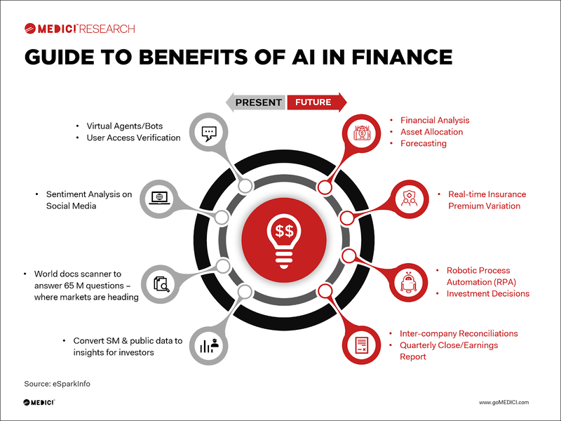

Slide 25
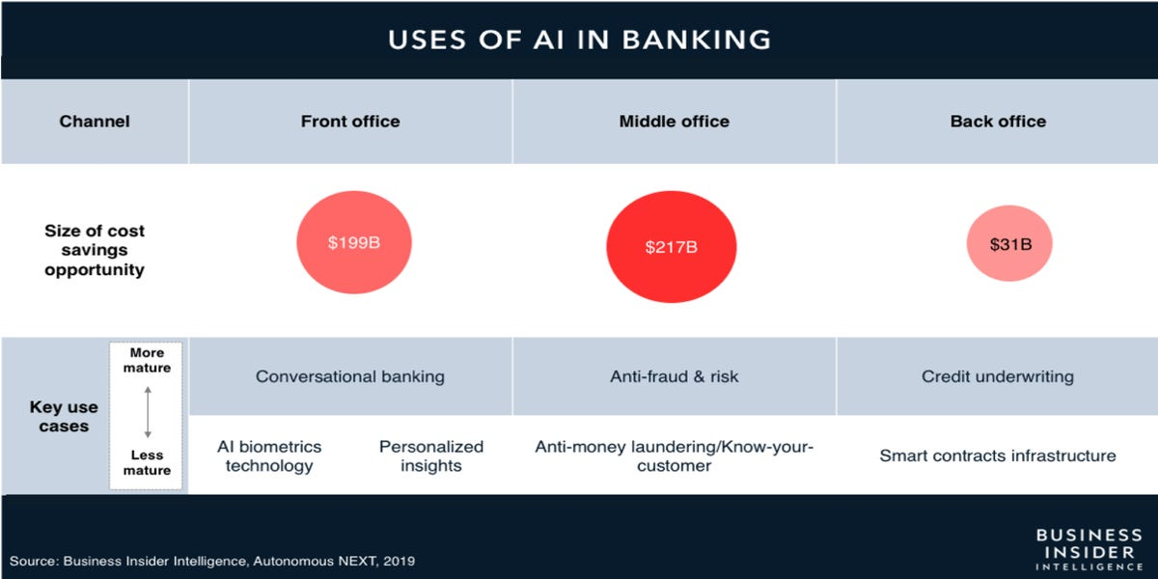

Slide 26
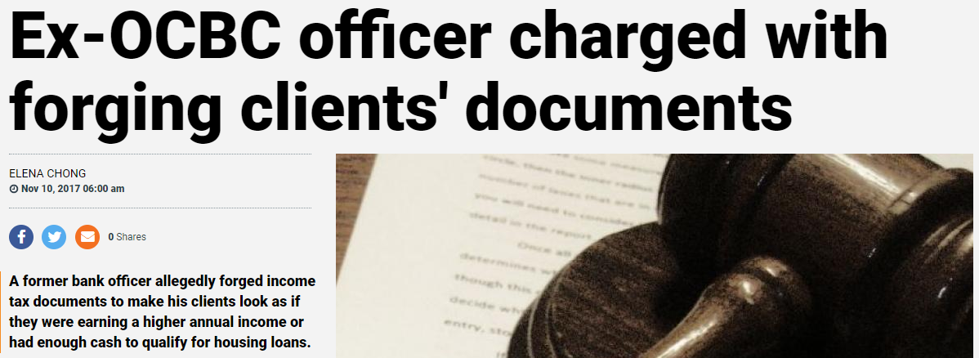
Data for banks: Security
Fraud Detection
Providing security is critical for both employees and customers.
With the scale of number of transactions, banks need to use Machine Learning as a proactive approach to security.
The key steps to fraud detection could include:
Data samplings for model estimation and preliminary testing
Model estimation
Testing
Source: https://www.tnp.sg/news/singapore/ex-ocbc-officer-charged-forging-clients-documents

Slide 27
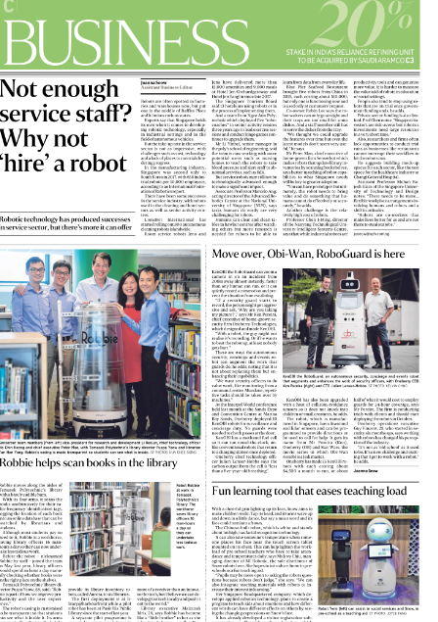
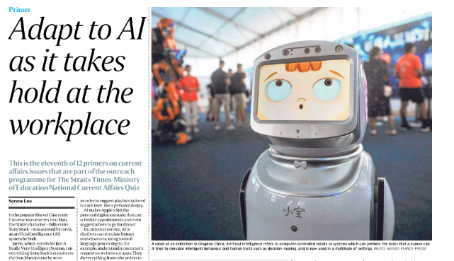
Why not hire a robot? Straits Times - 13 Aug 2019 Teachers Librarian Security Guard

Slide 28
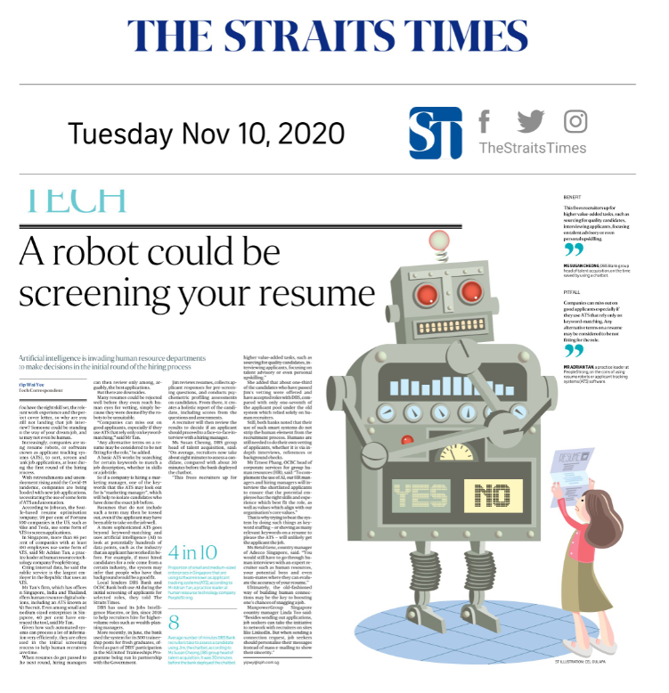

Slide 29
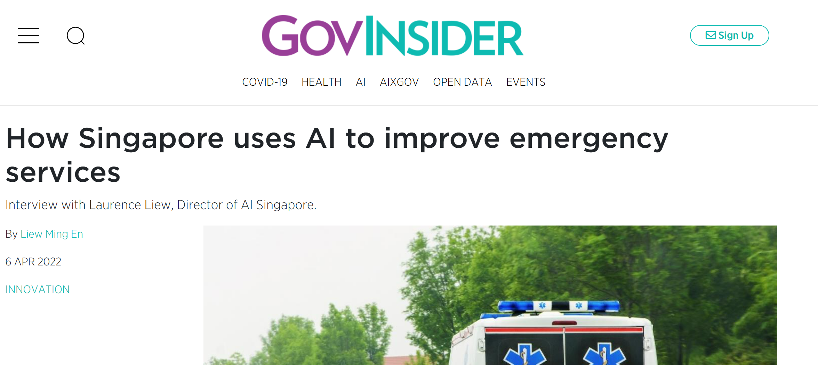
News – April 2022 AISG Under Hokkien 94% accuracy

Slide 30
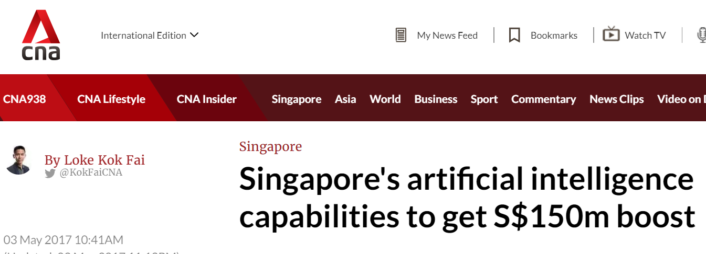
National Research Foundation (PMO): S$150million in AISG (May 2017)
https://www.nrf.gov.sg/profgrammes/artificial-intelligence-r-d-programme

Slide 31
Brains and Computers
Brain
200 billion neurons, 32 trillion synapses
Processing speed: 100 Hz
Parallel
Inputs are approximately summed
Computer
1 billion bytes RAM but trillions of bytes on disk
Processing speed: 10⁹ Hz
Serial
Activation Function : Sum

Slide 32
Deep Learning, Big Data, Distributed Computation
Deep Learning (LSTM by TensorFlow)
Big Data (Hadoop)
Large Distributed Computation (Spark)

Slide 33
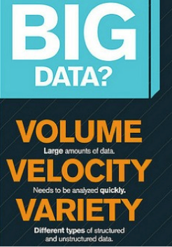

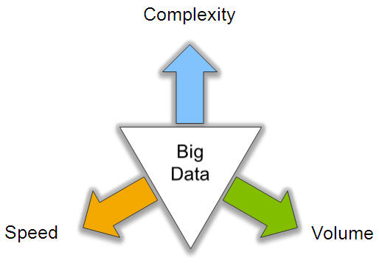
Big Data: 3V’s

Slide 34
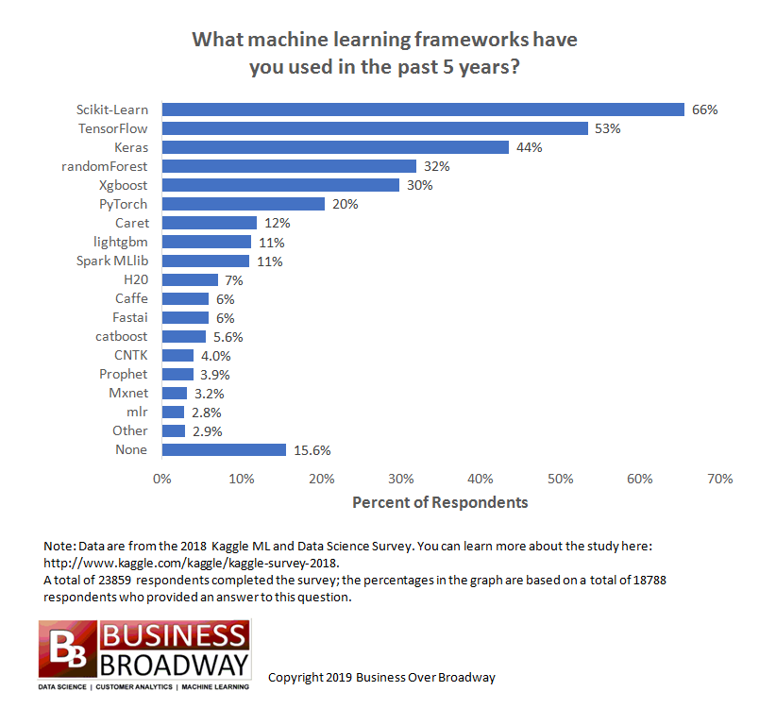

Slide 35
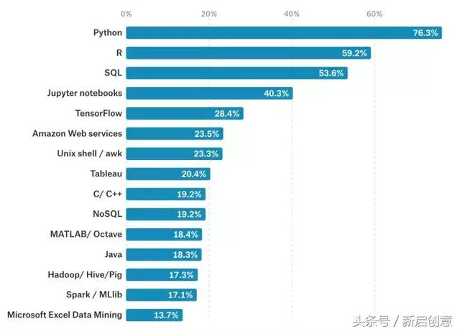
Programming Language for AI

Slide 36
AI Models

Slide 37
Top 10 Machine Learning Algorithms Every Engineer must know
Naive Bayes Classifier Algorithm
K Means Clustering Algorithm
Support Vector Machine Algorithm
Apriori Algorithm
Linear Regression
Logistic Regression
Decision Tree
Random Forest
Artificial Neural Networks
Nearest Neighbours
https://www.dezyre.com/article/top-10-machine-learning-algorithms/202

Slide 38
AI Model and Popular Application
Classifier (Supervised) – Machine Learning
Regression (Financial or Economic Prediction)
Decision Tree (Operation Research)
Random Forest (Operation Research)
XG-Boost (Operation Research)
SVM (Text, Handwriting and Biology Classification)
Naïve Bayesian (Document classification, Word Frequency)
Genetic Algorithm (Solar Collector, Antenna Location)
Multi-Layer Perceptron (General Classification)

Slide 39
AI Model – Deep Learning Model and Popular Application
Hidden Markov (Speech and Handwriting Recognition)
Recurrent Neural Network (Speech and Handwriting plus Time Series Analysis)
Long Short Term Memory (Same as RNN)
Generative Adversarial Network (Fashion, Art, Game)
Convolution Neural Network (Picture Recognition)

Slide 40
AI Model
Clustering (Unsupervised)
K-Means (Market Segmentation) – KNN classifier
Gaussian Mixture Model (Market Segmentation)
Others
Reinforcement Learning (Robot, Autonomous Vehicle)
Auto-Encoder (Reduce dimension for Picture)
Kernel Density Estimator (Advance Data Wrangling technique to reduce outlier and noise)
Manifold Learning (Feature Selection for large Dimension)
Block Chain (Transaction base application like trading of share)
Robotic Process Automation (Automation)
Chatbot (Automation)

Slide 41
AI Model – Feature Selection
Kernel Density Estimator
Manifold Learning (Similar to PCA)
Correlation Coefficient
Random Forest

Slide 42
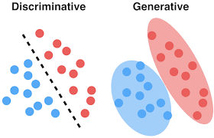
Types of ML
 | Probabilistic | Deterministic
Discriminative | Logistic Regression Probabilistic neural nets …….. | K-nn Linear classifier SVM Neural networks ……
Generative | Naïve Bayes Model-based (e.g., GMM) …… | N.A. (?)

Slide 43
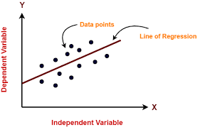
Regression

Slide 44
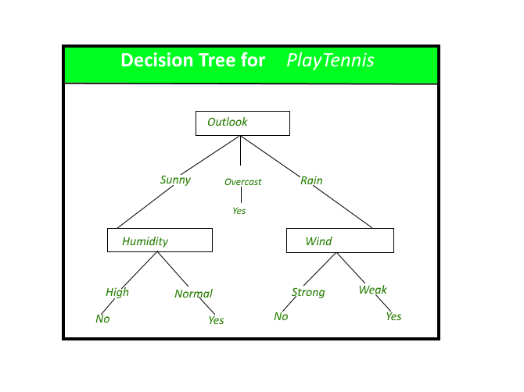
Decision Tree

Slide 45
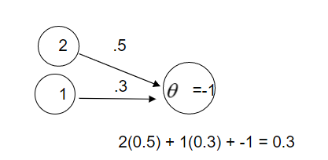
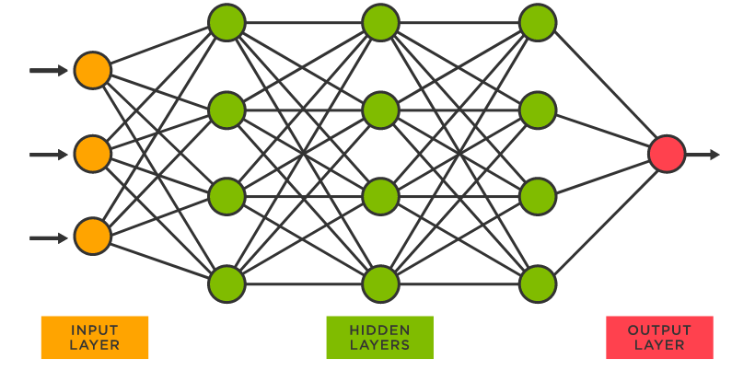
Neural Network

Slide 46

SVM

Slide 47
Advanced Technique

Slide 48

State of the Art – 2022 - Transfer Learning

Slide 49


Dual Neural Network GAN – Generative Adversarial Network

Slide 50

Dual Neural Network Chatbot with dual LSTM

Slide 51

Transfer Learning – CNN Resnet – Pre-trained Model
14 million images manually labeled with over 22,000 categories
available for anyone to experiment with, saving us the time and expense of having to do the training from scratch.
https://medium.com/analytics-vidhya/how-to-train-your-resnet-the-jindo-dog-50551117381d

Slide 52

Transformer, Encoder, Attention RNN
The transformer is the model, while the attention is a technique used by the model.

Slide 53
Others about AI

Slide 54

Library

Slide 55
Python
Basic Python – Variable, control flow, function
Data Structure – Array, list, dictionary, stack, queue
OOP – Class, subclass, instance, object, constructor, methods, private, static, abstract
SQL – CRUD
Network – Socket, REST API, json & json-server, XML, request, configuration file
Others – Decorator, Generator, Lamba, Exception, PIP, PYC, PyPI, Namespace, Virtual Environment, Multiple Variable, configuration, Multi-threading, Pipe, file, Magic, tktinker, Pickle & Shelve
Excel Using Python

Slide 56
Software Needed
Google Colab
Anaconda
R & R Studio
R Studio Cloud
Orange (Non Coding Tools)
Snatchbot (Non Coding Tools)

Slide 57
Libraries & Packages
Tensor Flow
Keras
Numpy
Scipy
Pandas
SK Learn

Slide 58

Structured and Un-Structured Data

Slide 59

Human Senses

Slide 60

Reinforcement Learning

Slide 61
Y, Dependent Variable, Label, Target
Usually on the 1st or Last Column
Continuous also know as Regression
Categorical, also know as Classification (can be 2or more categories)

Slide 62

Categorical aka Classification Y: Accuracy
https://images.app.goo.gl/yGHjQrE27emHFTRd7

Slide 63


Continuous aka Regression Y
MSE
RMSE

Slide 64

Categorical X
R – Factor or Hard Coded
Python – Dummy or One Hot Encoding or Hard Coded

Slide 65

Generalization & Regularization
https://towardsdatascience.com/generalization-regularization-overfitting-bias-and-variance-in-machine-learning-aa942886b870

Slide 66
Other Regularization Method (Avoid overfitting)
Regression: Lasso, Ridge
Decision Tree: Pruning
Neural Network: Dropout

Slide 67

Cross Validation

Slide 68

Data Cleaning/Wrangling - Outlier

Slide 69




Data Cleaning/Wrangling - Imbalance Data Oversampling/Under-sampling - SMOTE

Slide 70


Data Cleaning/Wrangling Missing Data (Non time series)

Slide 71

Data Cleaning/Wrangling - PCA

Slide 72

Anomaly Detection (SVM)

Slide 73

Data Cleaning/Wrangling - Missing Data (time series)

Slide 74
Descriptive vs Predictive (Structured Data)
Descriptive | Predictive
Statistic (Min, Medium, Mean, Max, Distribution Analysis, Standard Deviation, Confidence Interval) Hypothesis Testing Bar Plot | Regression Decision Tree Neural Network

Slide 75
Feature Engineering – Ranking and Selection
 | Continuous | Categorical/Classification
Regression | t-test (* in R) | OR
Decision Tree | Feature Ranking Function (variable.important) | Feature Ranking Function (variable.important)
Neural Network | GW | GW
Feature Selection Model | PCA, RELIEF | PCA, RELIEF
Statistical | Correlation (r) | Correlation (r)

Slide 76
Presentation
Web-based
Dash
PowerBi
Tableau
Excel

Slide 77
Thank You

Slide 78
APPENDIX

Slide 79
Useful Link (AI)
https://www.edureka.co/blog/interview-questions/artificial-intelligence-interview-questions/
https://intellipaat.com/blog/interview-question/artificial-intelligence-interview-questions/
https://www.springboard.com/blog/artificial-intelligence-questions/

Slide 80
Useful Link (Data Science)
https://www.simplilearn.com/tutorials/data-science-tutorial/data-science-interview-questions
https://towardsdatascience.com/over-100-data-scientist-interview-questions-and-answers-c5a66186769a
https://www.edureka.co/blog/interview-questions/data-science-interview-questions/
https://www.springboard.com/blog/data-science-interview-questions/

Slide 81
Youtube
https://youtu.be/2ePf9rue1Ao
https://youtu.be/ukzFI9rgwfU
https://youtu.be/ujTCoH21GlA
https://youtu.be/RnFGwxJwx-0
https://youtu.be/2BusGJyn77E

Slide 82




Turing Example: Write 110 then inverse
To write 110
Read Write Move
Blank 1 left
0 Stop
1 0 left
To Inverse
State Diagram representation

